Slide 1

Online Reverse-Dictionary using Multichannel Reverse-Dictionary Model (MRDM)
Introductory presentation for
Seminar
CS399
By: -
Tanishq Malu
1901CS63
15th Jan 2022

Slide 2

Index
1. Introduction
2. Previous Works
3. Multichannel Reverse Dictionary Model
(MRDM)
4. How it works?

Slide 3
Introduction
Reverse dictionary is a type of tool that lets you describe a concept and get back a list of words and phrases related to that concept. Your description can be anything at all: a single word, a few words, or even a whole sentence.
Reverse dictionaries are useful in practical applications. First and foremost, they can effectively solve the tip-of-the-tongue problem, namely the phenomenon of failing to retrieve a word from memory. Many people frequently suffer the problem, especially those who write a lot such as writers, researchers and students. With the help of reverse dictionaries, people can quickly and easily find the words that they need but temporarily forget.
In addition, reverse dictionaries are helpful to new language learners who grasp a limited number of words. They will know and learn some new words that have the meanings they want to express by using a reverse dictionary.
Also, reverse dictionaries can help word selection (or word dictionary) anomia patients, people who can recognize and describe an object but fail to name it due to neurological disorder

Slide 4
Previous Works
There have been few attempts to solve the problem using different algorithm and techniques, such as: -
Sentence Query - Definition Matching *
In this paper we describe a system allowing lookup of dictionary entries based on the description of the target entry. User input is parsed and then compared with definitions contained in the dictionary using a variety of similarity metrics. Only 50% of desired words were contained in the top 30 candidates returned by the system.
Neural Language Model **
It encodes the query description into a vector in the word embedding space, and returns the words with the closest embeddings to the vector of the query description Performance of this method depends largely on the quality of word embeddings. Unfortunately, according to Zipf’s law (Zipf, 1949), many words are low- frequency and usually have poor embeddings.
* https://anlp.jp/proceedings/annual_meeting/2004/pdf_dir/D4-5.pdf
** https://aclanthology.org/Q16-1002.pdf

Slide 5
Previous Works
Thorat and Choudhari (2016) present a node-graph architecture which can directly measure the similarity between the input query and any word in a word graph. However, it works on a small lexicon (3, 000 words) only.
Hill et al. (2016) propose a NLM based reverse dictionary model, which uses a bag-of-words (BOW) model or an LSTM to embed the input query into the semantic space of word embeddings, and returns the words whose embeddings are closest to the representation of the input query.
Following the NLM model, Morinaga and Yamaguchi (2018) incorporate category inference to eliminate irrelevant results and achieve better performance; Kartsaklis, Pilehvar, and Collier (2018) employ a graph of WordNet synsets and words in definitions to learn target word representations together with a multi-sense LSTM to encode input queries, and they claim to deliver state-of-the-art results;
Hedderich et al. (2019) use multi-sense embeddings when encoding the queries, aiming to improve sentence representations of input queries;
Pilehvar (2019) adopt sense embeddings to disambiguate senses of polysemous target words.

Slide 6
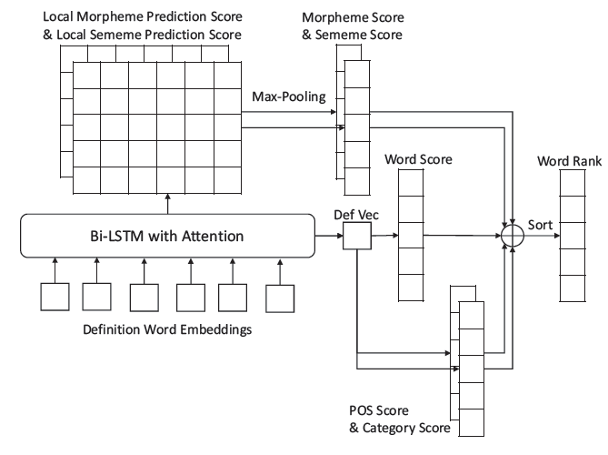
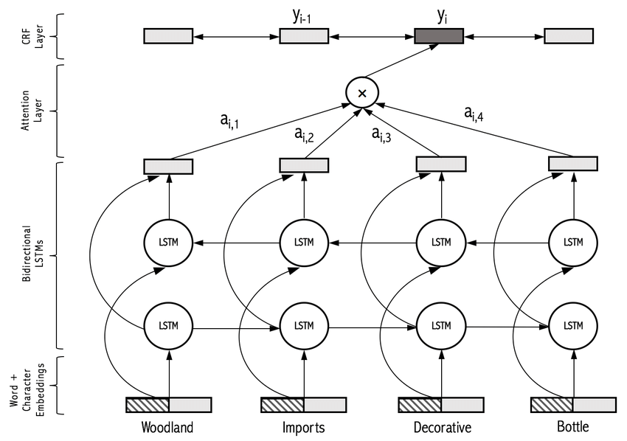
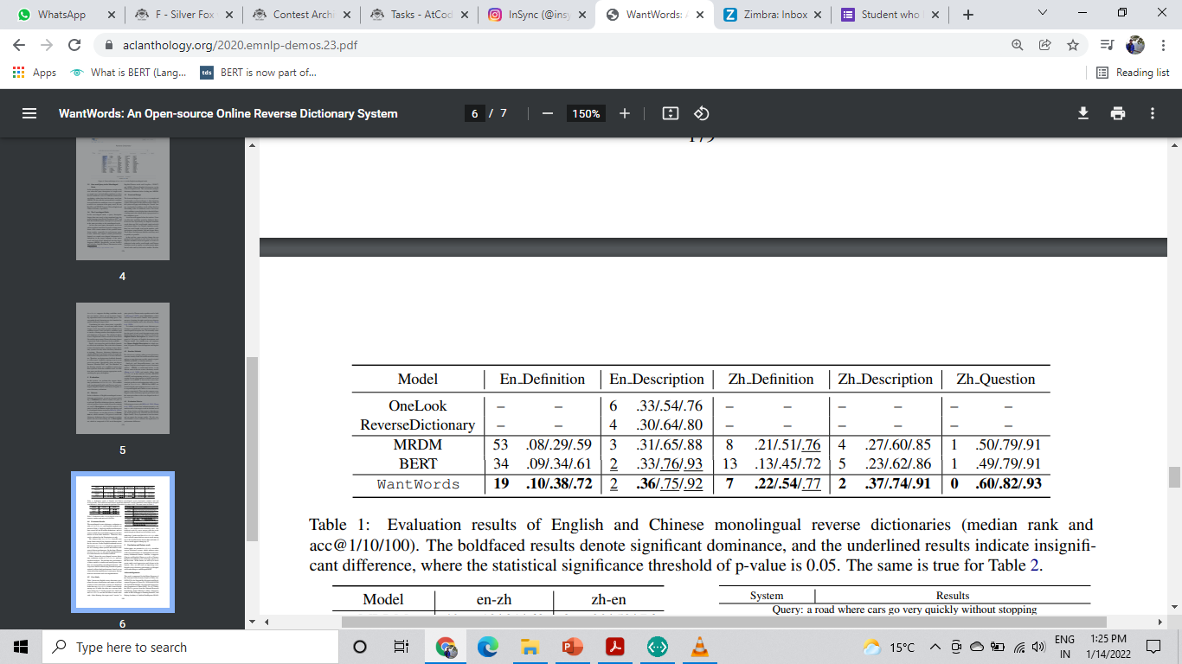
MRDM

Slide 7

RNN
Recurrent Neural Network(RNN) are a type of Neural Network where the output from previous step are fed as input to the current step
The main and most important feature of RNN is Hidden state, which remembers some information about a sequence.
An RNN remembers each and every information through time. It is useful in time series prediction only because of the feature to remember previous inputs as well. This is called Long Short Term Memory.

Slide 8
Bi-LSTM
A Bidirectional LSTM, or biLSTM, is a sequence processing model that consists of two LSTMs: one taking the input in a forward direction, and the other in a backwards direction.
Bidirectional recurrent neural networks(RNN) are really just putting two independent RNNs together. This structure allows the networks to have both backward and forward information about the sequence at every time.
BiLSTMs effectively increase the amount of information available to the network, improving the context available to the algorithm

Slide 9

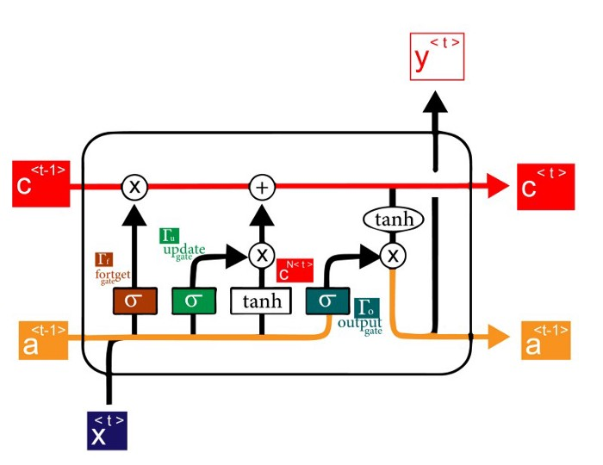
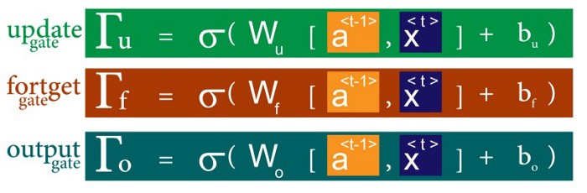
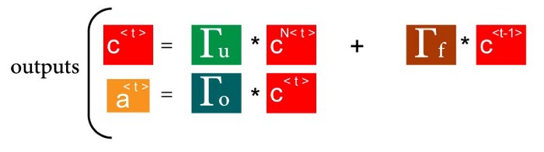
Working
Model

Slide 10
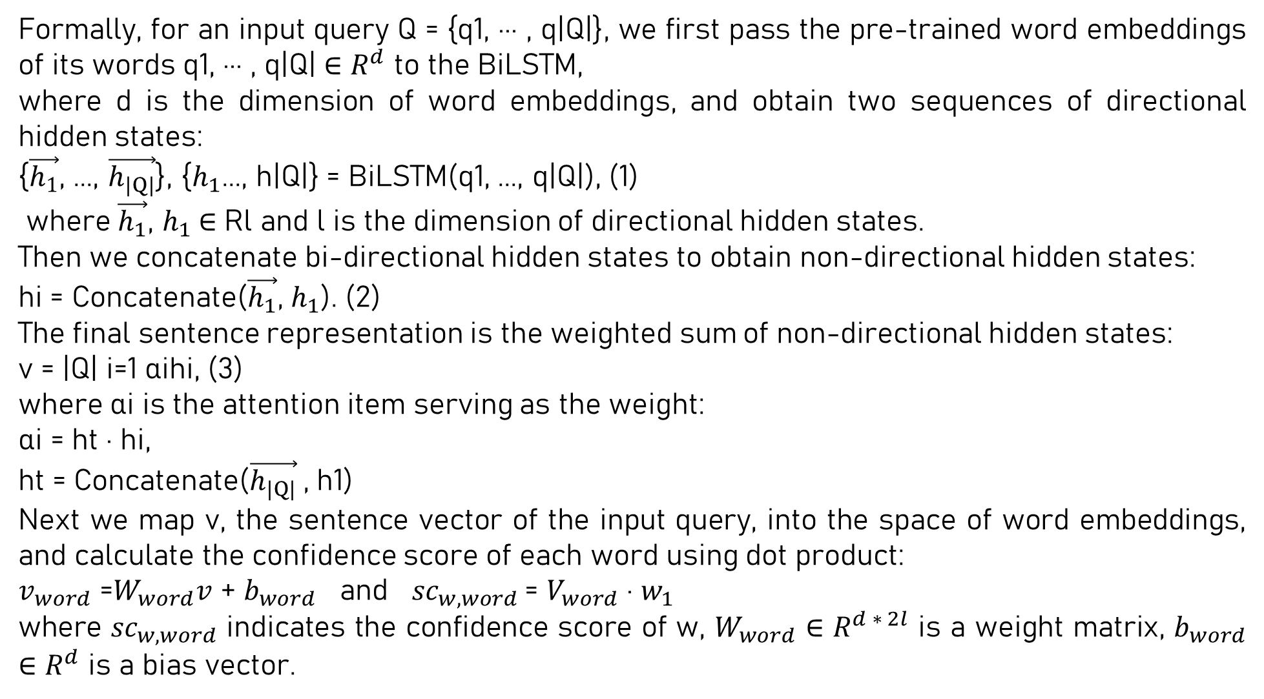
Formally, for an input query Q = {q1, ··· , q|Q|}, we first pass the pre-trained word embeddings of its words q1, ··· , q|Q| ∈ $R^{d}$ to the BiLSTM,
where d is the dimension of word embeddings, and obtain two sequences of directional hidden states:
{$\vec{h_{1}}$, ..., $\vec{h_{|Q|}}$}, {$h_{1}$..., h|Q|} = BiLSTM(q1, ..., q|Q|), (1)
where $\vec{h_{1}}$, $h_{1}$∈ Rl and l is the dimension of directional hidden states.
Then we concatenate bi-directional hidden states to obtain non-directional hidden states:
hi = Concatenate($\vec{h_{1}}$, $h_{1}$). (2)
The final sentence representation is the weighted sum of non-directional hidden states:
v = |Q| i=1 αihi, (3)
where αi is the attention item serving as the weight:
αi = ht · hi,
ht = Concatenate($\vec{h_{|Q|}}$, h1)
Next we map v, the sentence vector of the input query, into the space of word embeddings, and calculate the confidence score of each word using dot product:
$v_{word}$ =$W_{word}v$ + $b_{word}$ and ${sc}_{w,word}$= $V_{word}$ · $w_{1}$
where ${sc}_{w,word}$ indicates the confidence score of w, $W_{word}$ ∈ $R^{d ∗ 2l}$ is a weight matrix, $b_{word}$ ∈ $R^{d}$ is a bias vector.
←
←
←
←
←

Slide 11
MRDM
PoS Tag predictor
Morphere Tag predictor
Word category predictor
Sememe predictor

Slide 12
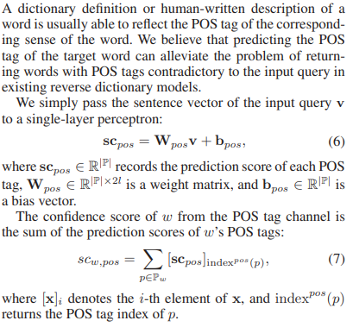
MRDM
PoS Tag predictor

Slide 13
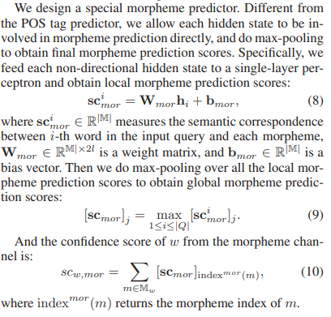
MRDM
Morpheme Tag predictor

Slide 14
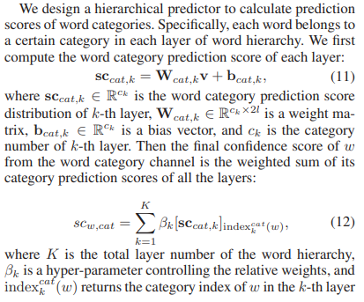
MRDM
Word category predictor

Slide 15
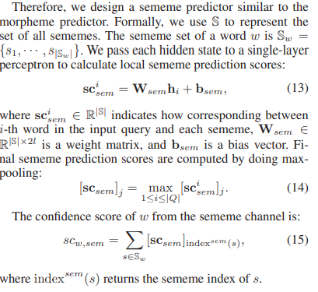
MRDM
Sememe predictor

Slide 16
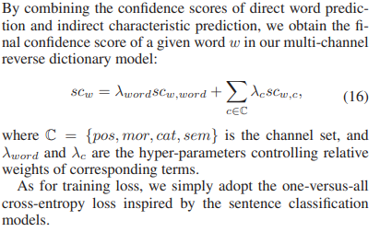
MRDM
MRDM Confidence score

Slide 17
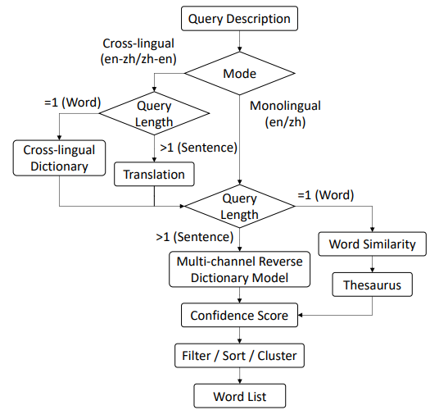
How it works?
In the monolingual mode, if the query description is longer than one word, it will be fed into the multichannel reverse dictionary model directly, which calculates a confidence score for each candidate word in the vocabulary; if the query description is just a word, the confidence score of each candidate word is mostly based on the cosine similarity between the embeddings of the query word and candidate word.
After obtaining confidence scores, all candidate words in the vocabulary will be sorted by descending confidence scores and listed as system output. The words in the query description are excluded since they are unlikely to be the target word. Different filters, other sort methods and clustering may be further employed to adjust the final results

Slide 18


